Slide 1
Threads Modified by Jan Janoušek
© University of Linz, Institute for System Software, 2004
published under the Microsoft Curriculum License

Slide 2
Threads

Slide 3
Threads
System.Threading
Synchronization
Thread pool
Important types
classes Thread and ThreadPool
enumerators ThreadState and ThreadPriority
class Monitor
Exceptions ThreadAbortException and ThreadInterrupedException
delegates ThreadStart, WaitCallBack, TimeCallBack, IOCompletionCallBack, ...
...

Slide 4
Types (excerpt)
public sealed class Thread {
public static Thread CurrentThread { get; } // static methods
public static void Sleep(int milliSeconds) {...} // Suspend the thread for a specified period of time
...
public Thread(ThreadStart startMethod) {...} // thread creation
public string Name { get; set; } // properties
public ThreadPriority Priority { get; set; }
public ThreadState ThreadState { get; }
public bool IsAlive { get; }
public bool IsBackground { get; set; }
... //methods
public void Start() {...} // Run a thread that is created and waiting in the un-started state
public void Suspend() {...} // Change the status of a running thread to suspended
public void Resume() {...} // Change the status of a suspended thread to running
public void Join() {...} // Block the main thread, until the specified thread finishes execution
public void Abort() {...} // throws ThreadAbortException
public void Interrupt() {...} // callable in WaitSleepState
...
}
public delegate void ThreadStart(); // parameterless void method
public enum ThreadPriority {Normal, AboveNormal, BelowNormal, Highest, Lowest}
public enum ThreadState {Unstarted, Running, Suspended, Stopped, Aborted, ...}

Slide 5
Delegates
ThreadStart Delegate
http://msdn.microsoft.com/en-us/library/system.threading.threadstart.aspx
ParameterizedThreadStart Delegate
http://msdn.microsoft.com/en-us/library/system.threading.parameterizedthreadstart.aspx

Slide 6
Starting a thread
Thread thread = new Thread(new ThreadStart (ThreadFunc));
//Creates a thread object
// ThreadStart identifies the method that the thread executes when it
//starts
thread.Start();
//starts the thread running
Thread Priorities :
Controls the amount of CPU time that can be allotted to a thread.
ThreadPriority.Highest
ThreadPriority.AboveNormal
ThreadPriority.Normal
ThreadPriority.BelowNormal
ThreadPriority.Lowest

Slide 7
Delegate ThreadStart 1/2
class Work
{
private int data;
public int Data
{
get { return data; }
set { data = value; }
}
public static void DoWork()
{
Console.WriteLine(„Static method");
}
public void DoMoreWork()
{
Console.WriteLine(„Instance method. Data = {0}", Data);
}
}

Slide 8
Delegate ThreadStart 2/2
class Test
{
static void Main()
{
ThreadStart threadDelegate = new ThreadStart(Work.DoWork);
Thread newThread = new Thread(threadDelegate);
newThread.Start();
// Delegate ThreadStart is not required in .NET > 2.0
Work w = new Work();
w.Data = 42;
threadDelegate = w.DoMoreWork;
newThread = new Thread(threadDelegate);
newThread.Start();
}
}

Slide 9
Example
using System;
using System.Threading;
class Printer {
char ch;
int sleepTime;
public Printer(char c, int t) {ch = c; sleepTime = t;}
public void Print() {
for (int i = 0; i < 100; i++) {
Console.Write(ch);
Thread.Sleep(sleepTime);
}
}
}
class Test {
static void Main() {
Printer a = new Printer('.', 10);
Printer b = new Printer('*', 100);
new Thread(a.Print).Start();
new Thread(b.Print).Start();
}
}
The program runs until the last thread stops.
Two threads which continuously
print characters on the screen

Slide 10
Differences to Java
C#
Java
void P() {
... thread actions ...
}
Thread t = new Thread(P);
class MyThread extends Thread {
public void run() {
... thread actions ...
}
}
Thread t = new MyThread();
Does not require a subclass of Thread
Any parameterless void method can be started as a thread.
Abort method => ThreadAbortException Can be caught, but is re-thrown at the end of the catch clause, unless ResetAbort is called. All finally blocks are executed (also the Exit of a monitor).
User-defined thread must be a subclass of Thread or implement Runnable.
Thread actions must be implemented in a method run.
stop method is deprecated because it can release a monitor in an inconsistent state.

Slide 11
Thread States
Thread t = new Thread(P);
Console.WriteLine("name={0}, priority={1}, state={2}", t.Name, t.Priority, t.ThreadState);
t.Name = "Worker"; t.Priority = ThreadPriority.BelowNormal;
t.Start();
Thread.Sleep(1);
Console.WriteLine("name={0}, priority={1}, state={2}", t.Name, t.Priority, t.ThreadState);
t.Suspend();
Thread.Sleep(1);
Console.WriteLine("state={0}", t.ThreadState);
t.Resume();
Console.WriteLine("state={0}", t.ThreadState);
t.Abort();
Thread.Sleep(1);
Console.WriteLine("state={0}", t.ThreadState);
Output
name=, priority=Normal, state=Unstarted
name=Worker, priority=BelowNormal, state=Running
state=Suspended
state=Running
state=Stopped

Slide 12
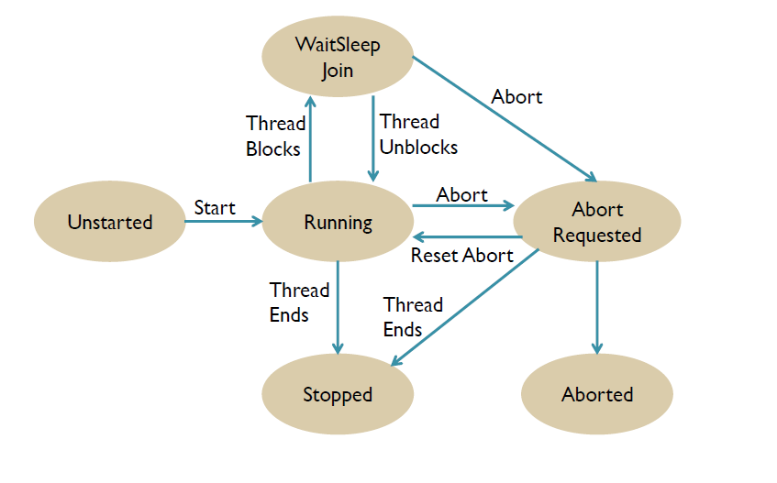
State Diagram of a Thread

Slide 13
Example for Join
using System;
using System.Threading;
class Test {
static void P() {
for (int i = 0; i < 20; i++) {
Console.Write('-');
Thread.Sleep(100);
}
}
static void Main() {
Thread t = new Thread(P);
Console.Write("start");
t.Start();
t.Join(); // waits for t
Console.WriteLine("end");
}
}
Output
start--------------------end

Slide 14
Prevent itself from being terminated
A thread can prevent itself from being terminated with Thread.ResetAbort.
try{
…
}
catch(ThreadAbortException){
Thread.ResetAbort();
}
Thread.Join()
When one thread terminates another, wait for the other thread to end.

Slide 15
Handling Abort
Abort throws an exception, which can be handled by the aborted thread.
using System; using System.Threading;
class Test {
static void P() {
try {
try {
try {
while (true) ;
} catch (ThreadAbortException) { Console.WriteLine("-- inner aborted"); }
} catch (ThreadAbortException) { Console.WriteLine("-- outer aborted"); }
} finally { Console.WriteLine("-- finally"); }
}
static void Main(string[] arg) {
Thread t = new Thread(P);
t.Start(); Thread.Sleep(1);
t.Abort(); t.Join(); Console.WriteLine("done");
}
}
Output
-- inner aborted
-- outer aborted
-- finally
done

Slide 16
Foreground and background threads
Two types of threads
Foreground
Background
Until foreground thread is executed, program will not finish (it will wait for the thread).
Background thread will be aborted when application finish (application will not wait for thre thread).
Background thread can be created using property IsBackground = true

Slide 17
Thread pool

Slide 18
Thread pool
ThreadPool provides set of threads
Advantages
Threads can be automatically reused (no need to create and destroy thread every time).
Better control.
Ideal for short tasks.
Threads in thread pool are background threads.
IsBackground is set to true
Class ThreadPool
Static method
GetAvailableThreads
GetMaxThreads
QueueUserWorkItem
SetMaxThreads

Slide 19
ThreadPool Class
using System;
using System.Threading;
public class Example
{
public static void Main()
{
ThreadPool.QueueUserWorkItem(new WaitCallback(ThreadProc));
Console.WriteLine(„The main thread will sleep");
Thread.Sleep(1000);
Console.WriteLine(„Main thread");
ThreadPool.QueueUserWorkItem(new WaitCallback(ThreadProc));
// Thread.Sleep(1000); - uncomment to execute thread from pool
Console.WriteLine(„Main thread finished.");
}
static void ThreadProc(Object stateInfo)
{
Thread.Sleep(100);
Console.WriteLine(„Hello from pool…");
}
}

Slide 20
Synchronization - Monitor

Slide 21
Mutual Exclusion
lock statement
lock(Variable) Statement
Example
class Account { // this class is a monitor
long val = 0;
public void Deposit(long x) {
lock (this) { val += x; } // only 1 thread at a time may execute this statement
}
public void Withdraw(long x) {
lock (this) { val -= x; }
}
}
Lock can be set to any object (not just to this)
object semaphore = new object();
...
lock (semaphore) { ... critical region ... }
No synchronized methods like in Java, but a corresponding attribute
[MethodImpl(MethodImplOptions.Synchronized)]
public void Deposit(long x) {...}

Slide 22
Monitor Class
lock(v) Statement
short form for
Monitor.Enter(v);
try {
Statement
} finally {
Monitor.Exit(v);
}
If a thread is aborted during the execution of Statement the finally clause is nevertheless executed and the monitor is released.

Slide 23
Monitor Class
Static methods
Enter
TryEnter
Exit
Wait
Pulse
PulseAll
lock (obj)
{
…
}
// is compiled as
Monitor.Enter(obj)
try
{
…
}
finally
{
Monitor.Exit(obj)
}

Slide 24
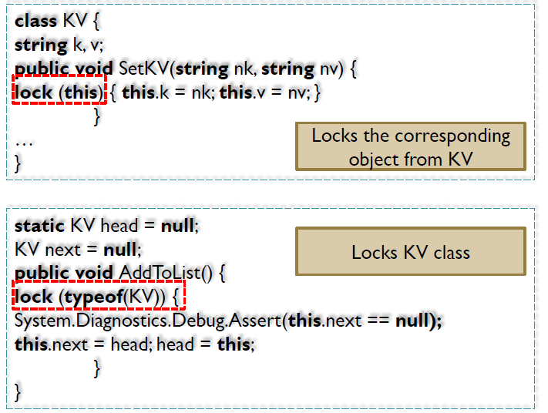
Continuing on Mutual Exclusion

Slide 25
Wait and Pulse
Monitor.Wait(lockedVar); ≈ wait() in Java (in Java lockedVar is always this)
Monitor.Pulse(lockedVar); ≈ notify() in Java
Monitor.PulseAll(lockedVar); ≈ notifyAll() in Java
Example
Thread A Thread B
lock(v) { lock(v) {
... ...
Monitor.Wait(v); Monitor.Pulse(v);
... ...
} }
1. A comes to lock(v) and proceeds because the critical region is free.
2. A comes to Wait, goes to sleep and releases the lock.
3. B comes to lock(v) and proceeds because the critical region is free.
4. B comes to Pulse and wakes up A. There can be a context switch between A and B, but not necessarily.
5. A tries to get the lock but fails, because B is still in the critical region.
6. At the end of the critical region B releases the lock; A can proceed now.
1
3
2
5
4
6

Slide 26
Wait and Pulse (continued)
Note
Wait(v) and Pulse(v) may only be called in a statement sequence that is protected with lock(v).
Between Pulse(v) and the continuation of the awakened thread other threads may run, which in the meantime have tried to obtain the lock (i.e. the condition signaled by Pulse need not be true any more when the awakened thread resumes after Wait!)
Therefore Wait should be enclosed in a loop that checks for the continuation condition:
while (condition false) Monitor.Wait(v);
...
make condition true;
Monitor.Pulse(v);
PulseAll(v) wakes up all threads that wait for v, but only one of them is allowed to continue. The others must wait until the previous one has released the lock. Then the next thread may enter the critical region.

Slide 27
Example: Synchronized Buffer
class Buffer {
const int size = 4;
char[] buf = new char[size];
int head = 0, tail = 0, n = 0;
public void Put(char ch) {
lock(this) {
while (n == size) Monitor.Wait(this);
buf[tail] = ch; tail = (tail + 1) % size; n++;
Monitor.PulseAll(this);
}
}
public char Get() {
lock(this) {
while (n == 0) Monitor.Wait(this);
char ch = buf[head]; head = (head + 1) % size;
n--;
Monitor.PulseAll(this);
return ch;
}
}
}
If producer is faster
Put
Put
Put
Put
Get
Put
Get
...
If consumer is faster
Put
Get
Put
Get
...

Slide 28
Synchronization - Mutex

Slide 29
Mutex Class
Mutex is used to synchronize access to shared resources
In case a thread already acquired the mutex, another thread requiring the mutex will be blocked until the mutex is released
But, how is Mutex different than using
Unlike monitor, mutex can be used for inter-process synchronization.
Mutex can be of two types:
Local Mutex (also called unnamed mutex): this type is used to synchronize threads within a process
Gloabal Mutex (also called named mutex): this type is used to synchronize inter-process threads (at OS level)

Slide 30

Mutex Class
Differentiating the two occurs during creation:
If you create a mutex without giving it a name it is a local mutex. Example:
If you create a mutex and specify a name for it, the OS links it with an OS mutex with that name.

Slide 31
Mutex Class
Microsoft recommends using monitor for inter-thread communication and mutex for inter-process communication
The reason is that mutex implementation is heavy
Abandoned Mutex:
A mutex must be released using MutexRelease() method before the thread ends. Otherwise, it is said to be an abandoned Mutex and will throw an exception
An abandoned mutex questions the integrity of the data being protected by the mutex

Slide 32
class Program
{
private static Mutex m = new Mutex(false, "myMutexName");
static void Main(string[] args)
{
m.WaitOne();
try
{
Console.WriteLine("Started...");
Thread.Sleep(5 * 1000);
Console.WriteLine("Done...");
}
finally
{
m.ReleaseMutex();
}
Console.ReadLine();
}
}

Slide 33
Synchronization - semaphore

Slide 34
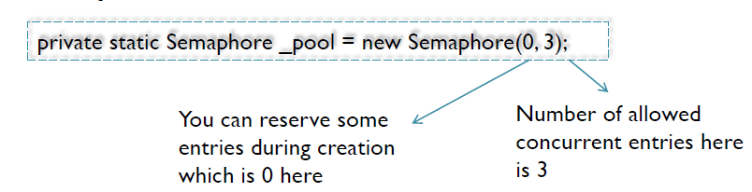
Semaphore Class
Almost similar to the Monitor Class, the only difference is that a semaphore defines the maximum number of threads to access the resource rather than restricting it to one thread
Below an example of defining a semaphore:
A semaphore is acquired by calling Wait() method and released by calling Release()
Whenever a semaphore is acquired the remaining number of slots to access the resource is decremented. When the number is 0, the calling thread will be suspended.

Slide 35
private static Semaphore s = new Semaphore(3, 3);
static void Main(string[] args) {
for (int i = 0; i < 10; i++) {
RunThread(i);
}
}
private static void RunThread(int i) {
Thread t = new Thread(() => {
while (true)
{
s.WaitOne();
Console.WriteLine(i);
Thread.Sleep(500);
s.Release();
}
});
t.Start();
}

Slide 36
[Synchronization]

Slide 37
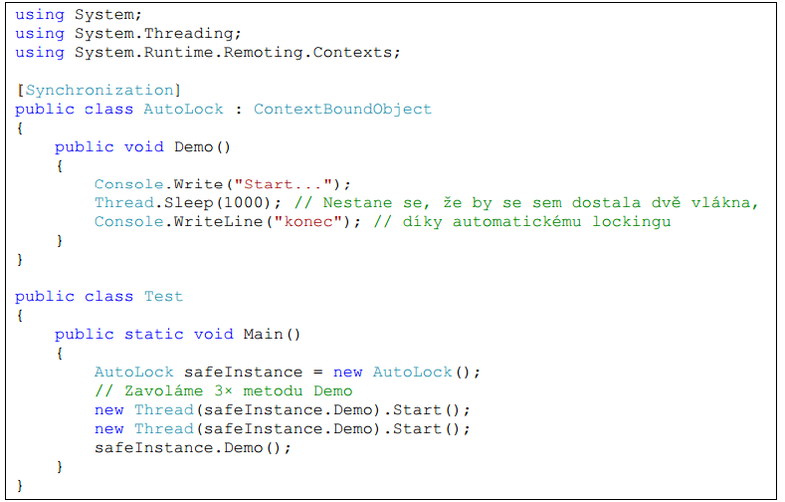

Slide 38
Other interesting classes

Slide 39
Interlocked
http://msdn.microsoft.com/en-us/library/dd78zt0c.aspx#Y631
The methods of this class help protect against errors that can occur when the scheduler switches contexts while a thread is updating a variable that can be accessed by other threads, or when two threads are executing concurrently on separate processors. The members of this class do not throw exceptions.
The Increment and Decrement methods increment or decrement a variable and store the resulting value in a single operation. On most computers, incrementing a variable is not an atomic operation, requiring the following steps:
Load a value from an instance variable into a register.
Increment or decrement the value.
Store the value in the instance variable.

Slide 40
System.Threading.Timer
Initializes a new instance of the Timer class with an infinite period and an infinite due time, using the newly created Timer object as the state object.
Call this constructor when you want to use the Timer object itself as the state object. After creating the timer, use the Change method to set the interval and due time.
http://msdn.microsoft.com/en-us/library/ms149618.aspx

Slide 41
System.Diagnostics.Stopwatch
using System;
using System.Diagnostics;
using System.Threading;
class Program
{
static void Main(string[] args)
{
Stopwatch stopWatch = new Stopwatch();
stopWatch.Start();
Thread.Sleep(10000);
stopWatch.Stop();
// Get the elapsed time as a TimeSpan value.
TimeSpan ts = stopWatch.Elapsed;
// Format and display the TimeSpan value.
string elapsedTime = String.Format("{0:00}:{1:00}:{2:00}.{3:00}",
ts.Hours, ts.Minutes, ts.Seconds,
ts.Milliseconds / 10);
Console.WriteLine(elapsedTime, "RunTime");
}
}

Slide 42
References
C# Threads, By Khaled Alanezi, Graduate Presentation CSCI 5448 OOAD – Spring 2011, University of Colorado, Boulder
Threads, University of Linz, Institute for System Software, 2004, published under the Microsoft Curriculum License
http://www.albahari.com/threading/threading_czech.pdf

